Slide 1
Applet Basics
A complete Applet Skeleton
Applet Initialization and Termination
A key Aspect of an Applet Architecture
Requesting Repainting
Using the status window
Passing parameters to Applets.

Slide 2
Applet Basics
Applet is a special type of program that is embedded in the webpage to generate the dynamic content. It runs inside the browser and works at client side.
Advantage of Applet
It works at client side so less response time
Secured
It can be executed by browsers running under many platforms, including Linux, Windows, Mac Os etc.

Slide 3
Cont..d
All applets are subclass of java.applet.Applet class
Execution of an applet does not begin at main(). Thus Applets do not need main( ) method.
Output is handled with various AWT methods, such as drawString(), which outputs a string to a specified X,Y location
To use an applet, it is specified in an HTML file using applet tag as follows
<applet code =“simpleApplet” width=200 height=60>
……………….
</applet code>
Applets must be run under an applet viewer or a Java-compatible browser.

Slide 4
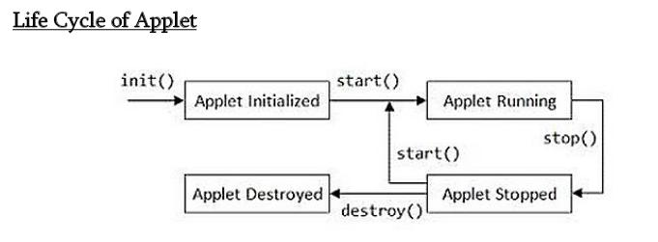
A complete Applet Skeleton

Slide 5
Cont..d
Most applets override the following 4 methods
init() : is the 1st method to be called.
This is called only once in the life cycle.
Initializes the applet and other variables and objects.
start(): automatically called after the init() method.
It is also called whenever the user returns to the page after gone off to other pages.

Slide 6
Cont..d
stop(): This method is called when user is gone off visiting the other pages and may return.
Stop() method just suspend the applet that is not visible, but applet is still exist .
destroy(): This method is called applet need to be removed completely from memory.

Slide 7
Cont..d
Applet need to override paint method of java.awt to display graphics on applet
paint(): Invoked immediately after the start() method.
Paint() is also called any time the applet needs to repaint itself in the browser.
The paint() method is actually inherited from the java.awt.

Slide 8
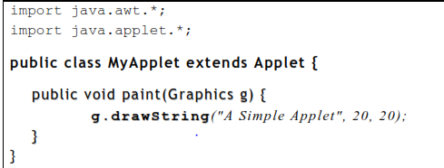
Simple applet program
First import statement imports the Abstract Window Toolkit (AWT) classes.
The AWT contains support for a window-based, graphical user interface.

Slide 9
The applet class must be declared as public,
because it will be accessed by code that is outside the program.
The paint( ) method must be overridden by the applet:
defined by the AWT
paint( ) is called each time the applet must redisplay its output.

Slide 10
Situations When paint is called.
When the applet begins execution.
The window in which the applet is running can be overwritten by another window and then uncovered.
The applet window can be minimized and then restored.
Whenever the applet must redraw its output, paint( ) is called.

Slide 11
Parameter: Graphics object which describes the graphics environment.
drawString( ):
is a member of the Graphics class.
This method outputs a string beginning at the specified location (X, Y).
general form:
void draw String(String message, int x, int y)
Here, message is the string to be output beginning at x, y.
In a Java window, the upper-left corner is location 0, 0.

Slide 12
Compilation and running .
In fact, there are two ways in which you can run an applet:
1. Executing the applet within a Java compatible web browser.
2. Using an appletviewer tool.

Slide 13
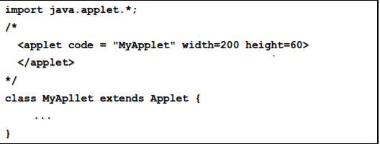
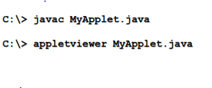
running applet using applet-viewer
First create html code in the applet program and comment it with c type comment.
- Consider the following applet program say MyApllet.java
Now you can run this program using appletviewer as shown below

Slide 14

running applet in web browser
To execute an applet in a web browser, you need to write a short HTML text file that contains a tag APPLET that loads the applet. Say file name as say RunApp.html
The width and height specify the dimensions of the display area used by the applet.

Slide 15
Applet initialization and termination
When an applet begins, the following methods are called, in this sequence:
init( )
start( )
paint( )
When an applet is terminated, the following sequence of method calls takes place:
stop( )
destroy( )

Slide 16
Cont..d
init( ) :
The init( ) method is the first method to be called.
Initializing the variables.
This method is called only once during the run time of the applet.
start( ) :
Called after init( ).
Also called to restart an applet after it has been stopped.
Called each time an applet’s HTML document is displayed onscreen

Slide 17
Cont..d
paint( ) :
Called each time an applet’s output must be redrawn.
Also called when the applet begins execution.
The method has one parameter of type Graphics.
This parameter will contain the graphics context, which describes the graphics environment in which the applet is running.
stop( ) :
Called when a web browser leaves the HTML document containing the applet.
Used to suspend threads that don’t need to run when the applet is not visible.
We can restart them when start( ) is called.

Slide 18
Cont..d
destroy( ) :
called when the environment determines that the applet needs to be removed
completely from memory.
The stop( ) method is always called before destroy( ).

Slide 19
import java.awt.*;
import java.applet.*;
import javax.swing.JOptionPane;
/* <applet code = DemoApplet HEIGHT =200 WIDTH=200>
</applet>
*/

Slide 20
public class DemoApplet extends Applet {
// First method to begin with.
public void init() {
JOptionPane.showMessageDia log (null, " I nit Method");
}
//Second method. Called after init.
public void start() {
JOptionPane.showMessageDialog (null, "Start Method");
}
// Called when the applet is stopped.
public void stop() {
JOptionPane.showMessageDialog (null, "Stop Method");
}

Slide 21
Requesting Repainting
Awt- based applet writes to its window only when its paint() method is called by the run-time system.
Whenever an applet needs to update the information displayed in its window, it simply calls repaint().
void repaint()

Slide 22
Using the status window
An applet can also output a message to the status window of the browser or applet viewer on which it is running.
General form
void showStatus(String msg)

Slide 23
Cont..d
import java.awt.*;
import java.applet.*;
/*<applet code=“StatusWin” width=300 height=50>
</applet>*/
public class StatusWin extends Applet{
public void paint(Graphics g){
g.drawString(“This is applet window”,10,20);
showStatus(“This is shown in the status window”)
}
}

Slide 24
Passing Parameters to Applets
APPLET tag in HTML allows you to pass parameters to your applet.
To retrieve a parameter, use the getParameter( ) method.
General form
String getParameter( String paramName)
It returns the value of the specified parameter in the form of a String object.
Thus, for numeric and boolean values, you will need to convert their string representations into their internal formats.

Slide 25
Example to pass parameter to an applet
<html>
<body>
<applet code="UseParam.class" width="300" height="300">
<param name="msg" value="Welcome to applet">
</applet>
</body>
</html>
import java.applet.*;
import java.awt.*;
public class UseParam extends Applet{
public void paint(Graphics g){
String str=getParameter("msg");
g.drawString(str,50, 50);
}
}

